Slide 1

CSE-4139 Machine Learning
Session II
Dr. Syed Akhter Hossain
Professor and Head, Department of CSE
aktarhossain@daffodilvarsity.edu.bd
Thursday 19 July, 2018 @ BAUST

Slide 2
Discussion Points
09:00-09:10 Review Status
09:10-10:00 Discussion on Neural Network
10:00-11:00 Working with Python
11:30-12:30 Discussion on ML research
12:30-12:50 Quiz based on discussion
Machine Learning @ BAUST, Session 2, July 2018

Slide 3
09:00-09:10 Review Status
What strengths drives you in ML?
How to visualize problem domain?
Can you infer real-life using ML?
What ML topics are interesting?
What are potential issues?
Machine Learning @ BAUST, Session 2, July 2018

Slide 4
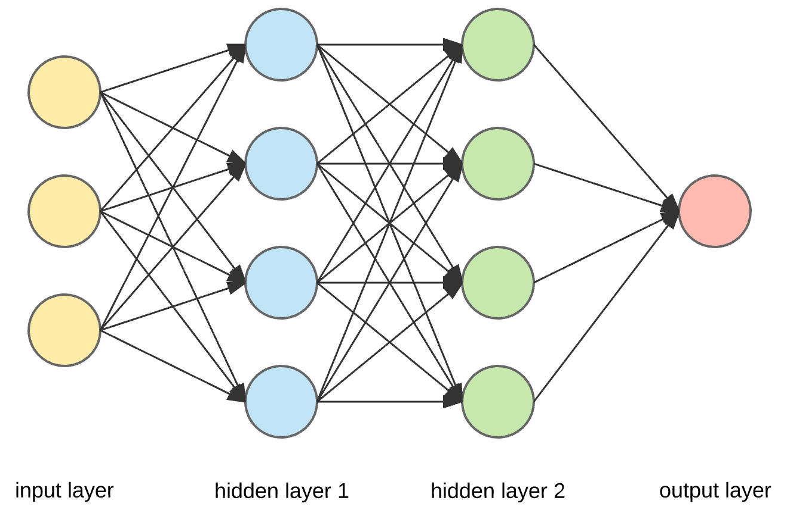
09:10-10:00 Discussion on
Neural Network
Machine Learning @ BAUST, Session 2, July 2018

Slide 5
Neural Networks
A NN is a machine learning approach inspired by the way in which the brain performs a particular learning task:
  Knowledge about the learning task is given in the form of examples.
  Inter neuron connection strengths (weights) are used to store the acquired information (the training examples).
  During the learning process the weights are modified in order to model the particular learning task correctly on the training examples.
Machine Learning @ BAUST, Session 2, July 2018
Notes:
NN 1
10-00
Elene Marchiori

Slide 6
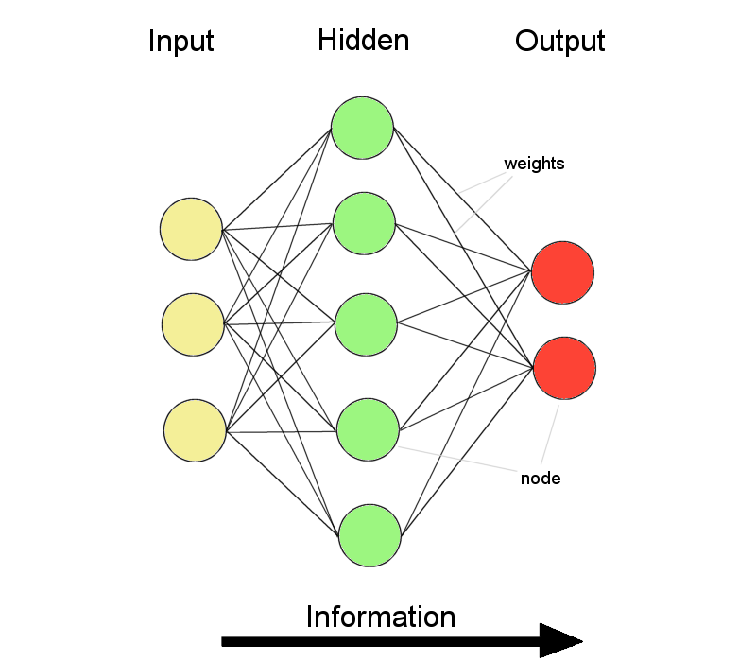
ANNs – The basics
ANNs incorporate the two fundamental components of biological neural nets:
Neurones (nodes)
Synapses (weights)
Machine Learning @ BAUST, Session 2, July 2018

Slide 7
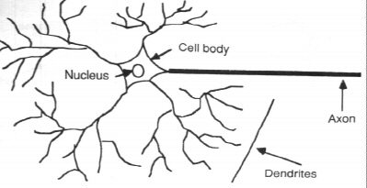
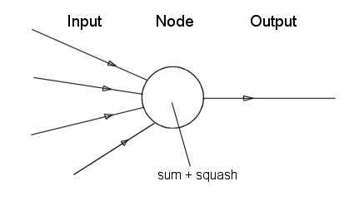
Neurone vs. Node
Machine Learning @ BAUST, Session 2, July 2018

Slide 8
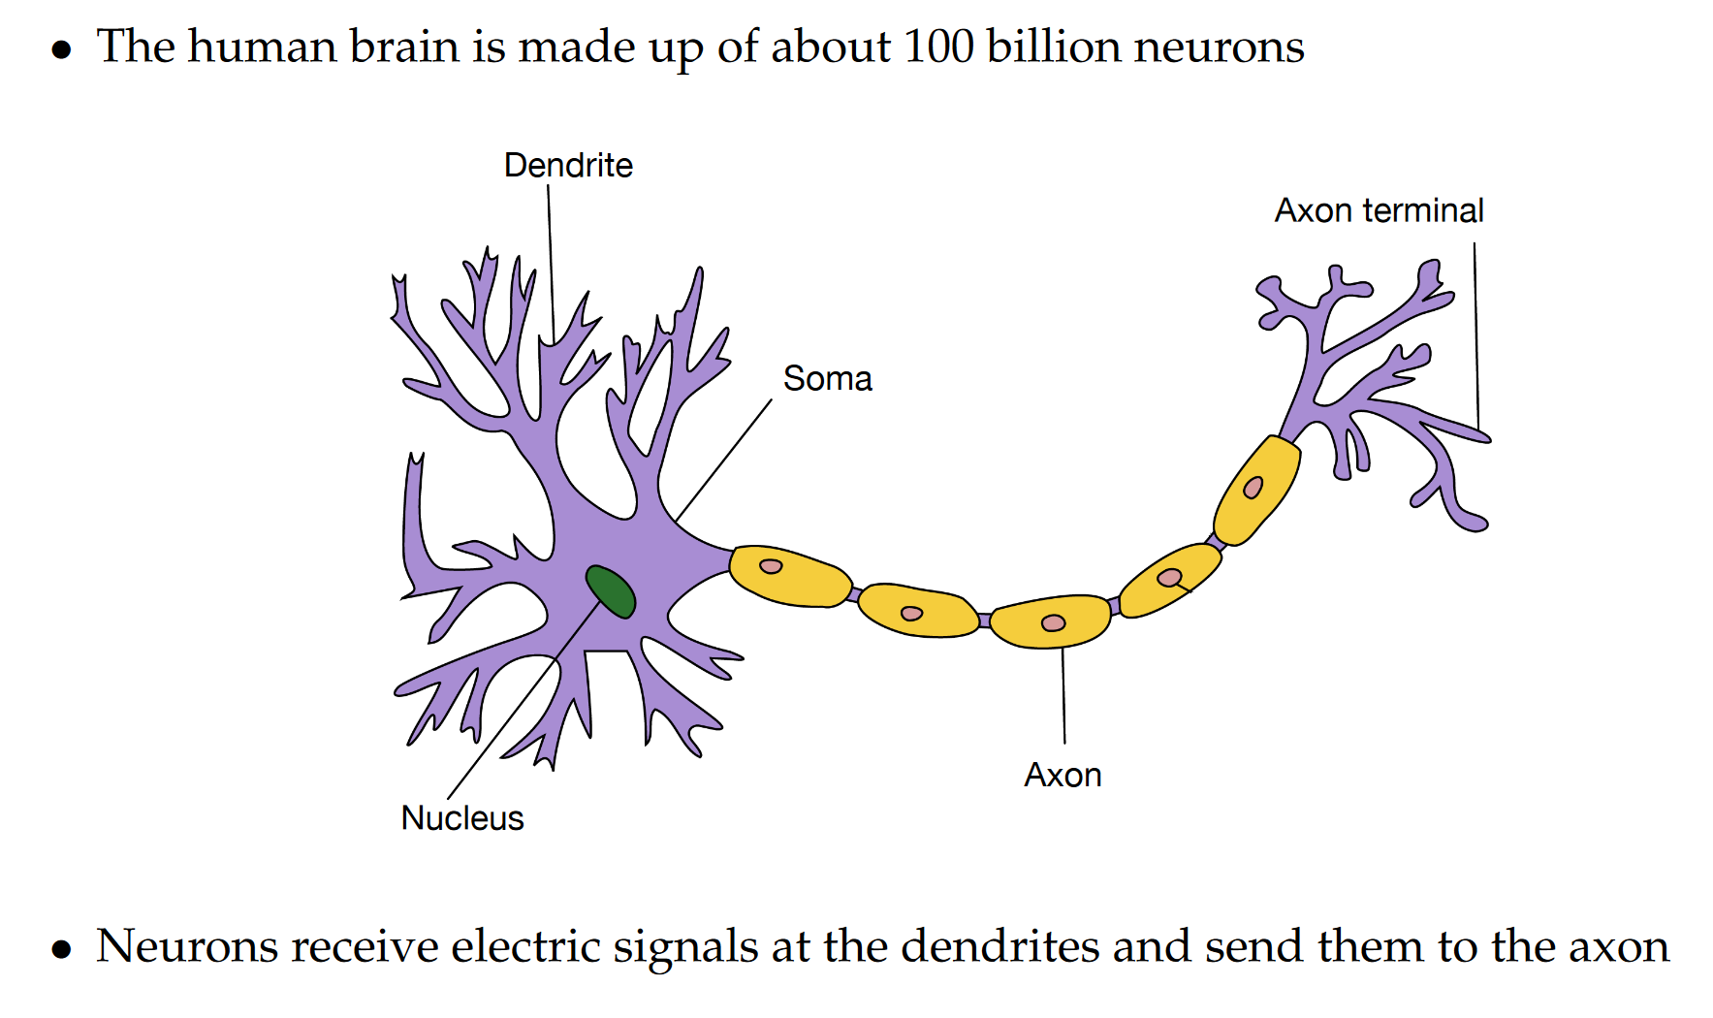
Neuron in Brain
Machine Learning @ BAUST, Session 2, July 2018

Slide 9
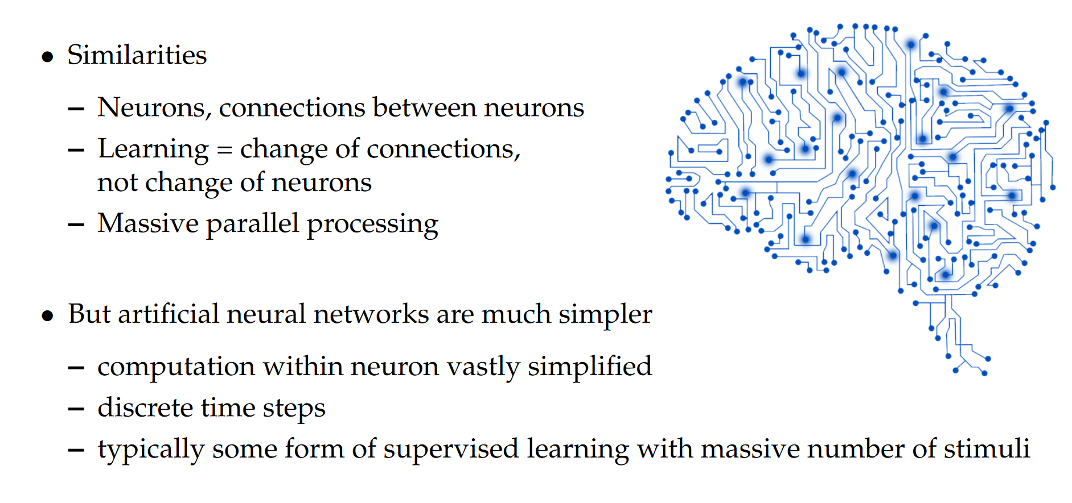
Brain vs. ANN
Machine Learning @ BAUST, Session 2, July 2018

Slide 10
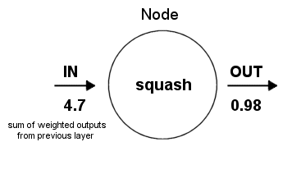
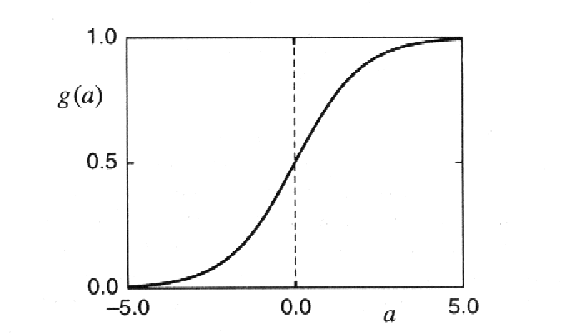
Structure of a node:
Squashing function limits node output:
Machine Learning @ BAUST, Session 2, July 2018

Slide 11
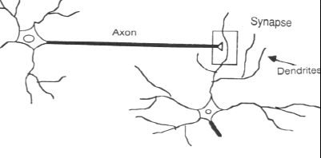
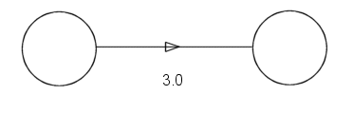
Synapse vs. weight
Machine Learning @ BAUST, Session 2, July 2018

Slide 12
Learning
Supervised Learning
  Recognizing hand-written digits, pattern recognition, regression.
  Labeled examples (input , desired output)
  Neural Network models: perceptron, feed-forward, radial basis function, support vector machine.
Unsupervised Learning
  Find similar groups of documents in the web, content addressable memory, clustering.
  Unlabeled examples (different realizations of the input alone)
  Neural Network models: self organizing maps, Hopfield networks.
Machine Learning @ BAUST, Session 2, July 2018
Notes:
NN 1
10-00
Elene Marchiori

Slide 13
Network Architectures
Three different classes of network architectures
  single-layer feed-forward neurons are organized
  multi-layer feed-forward in acyclic layers
  recurrent
The architecture of a neural network is linked with the learning algorithm used to train
Machine Learning @ BAUST, Session 2, July 2018
Notes:
NN 1
10-00
Elene Marchiori

Slide 14
Feed-forward Nets
Information flow is unidirectional
  Data is presented to Input layer
  Passed on to Hidden Layer
  Passed on to Output layer
Information is distributed
Information processing is parallel
Internal representation (interpretation) of data
Machine Learning @ BAUST, Session 2, July 2018

Slide 15
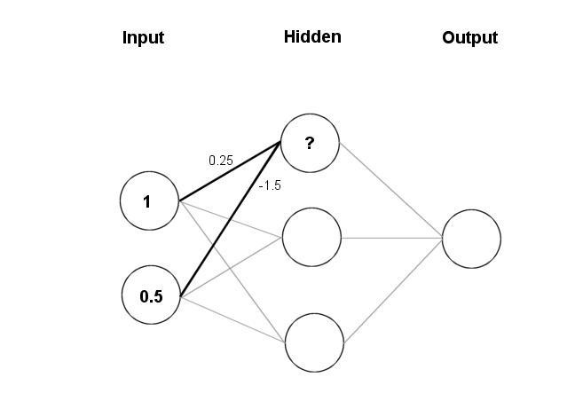
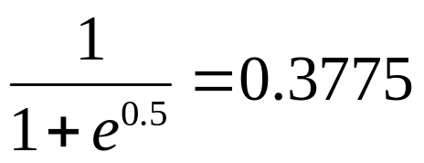
Feeding data through the net:
(1 × 0.25) + (0.5 × (-1.5)) = 0.25 + (-0.75) = - 0.5
Squashing:
Machine Learning @ BAUST, Session 2, July 2018

Slide 16
Data is presented to the network in the form of activations in the input layer
Examples
  Pixel intensity (for pictures)
  Molecule concentrations (for artificial nose)
  Share prices (for stock market prediction)
Data usually requires preprocessing
  Analogous to senses in biology
How to represent more abstract data, e.g. a name?
  Choose a pattern, e.g.
    0-0-1 for “Chris”
    0-1-0 for “Becky”
Machine Learning @ BAUST, Session 2, July 2018

Slide 17
Single Layer Feed-forward
Input layer
of
source nodes
Output layer
of
neurons
Machine Learning @ BAUST, Session 2, July 2018
Notes:
NN 1
10-00
Elene Marchiori

Slide 18
Multi layer feed-forward
3-4-2 Network
Input
layer
Output
layer
Hidden Layer
Machine Learning @ BAUST, Session 2, July 2018
Notes:
NN 1
10-00
Elene Marchiori

Slide 19
Recurrent network
Recurrent Network with hidden neuron(s): unit delay operator z⁻¹ implies dynamic system
z⁻¹
input
hidden
output
z⁻¹
z⁻¹
Machine Learning @ BAUST, Session 2, July 2018
Notes:
NN 1
10-00
Elene Marchiori

Slide 20
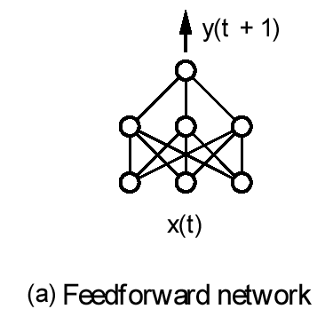
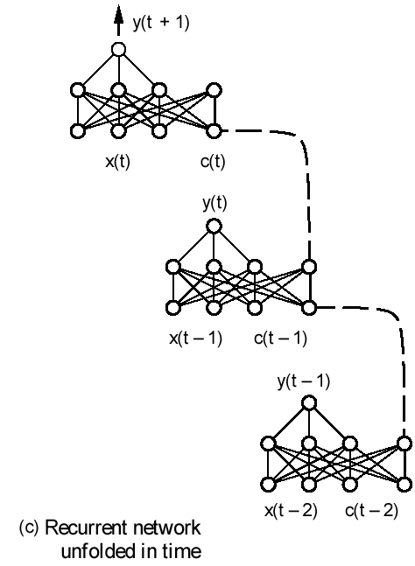
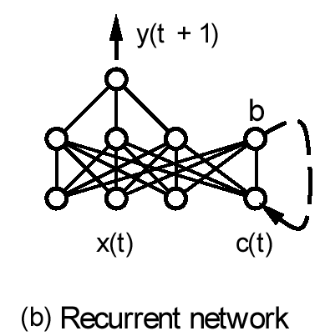
Neural Network Architectures
Machine Learning @ BAUST, Session 2, July 2018
Notes:
NN 1
10-00
Elene Marchiori

Slide 21
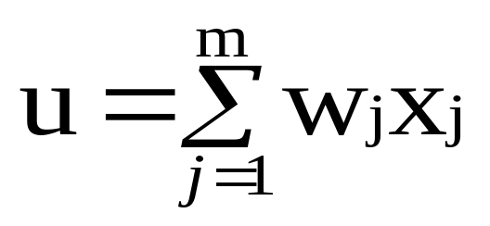

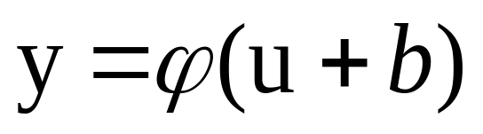
The Neuron
The neuron is the basic information processing unit of a NN. It consists of:
  A set of synapses or connecting links, each link characterized by a weight:
    W₁, W₂, …, W_{m}
  An adder function (linear combiner) which computes the weighted sum of the inputs:
  Activation function (squashing function) for limiting the amplitude of the output of the neuron.
Machine Learning @ BAUST, Session 2, July 2018
Notes:
NN 1
10-00
Elene Marchiori

Slide 22
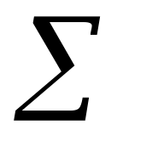
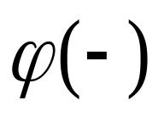

The Neuron
Bias
b
x₁
w₁
Activation
function
Local
Field
v
Output
y
Input
signal
x₂
w₂
Summing
function
x_{m}
w_{m}
Synaptic
weights
Machine Learning @ BAUST, Session 2, July 2018
Notes:
NN 1
10-00
Elene Marchiori

Slide 23
Bias of a Neuron
Bias b has the effect of applying an affine transformation to u
        v = u + b
v is the induced field of the neuron
v
u
Machine Learning @ BAUST, Session 2, July 2018
Notes:
NN 1
10-00
Elene Marchiori

Slide 24
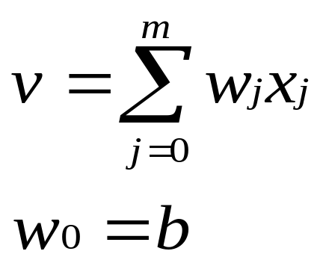
Bias as extra input
Bias is an external parameter of the neuron. Can be modeled by adding an extra input.
w₀
x₀ = +1
x₁
w₁
Activation
function
Local
Field
v
Input
signal
Output
y
x₂
w₂
Summing
function
x_{m}
w_{m}
Synaptic
weights
Notes:
NN 1
10-00
Elene Marchiori

Slide 25
Dimensions of a Neural Network
Various types of neurons
Various network architectures
Various learning algorithms
Various applications
Machine Learning @ BAUST, Session 2, July 2018
Notes:
NN 1
10-00
Elene Marchiori

Slide 26
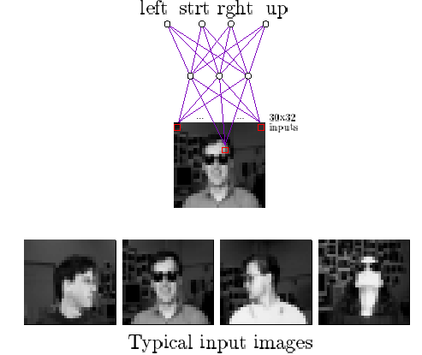
Face Recognition
90% accurate learning head pose, and recognizing 1-of-20 faces
Machine Learning @ BAUST, Session 2, July 2018
Notes:
NN 1
10-00
Elene Marchiori

Slide 27
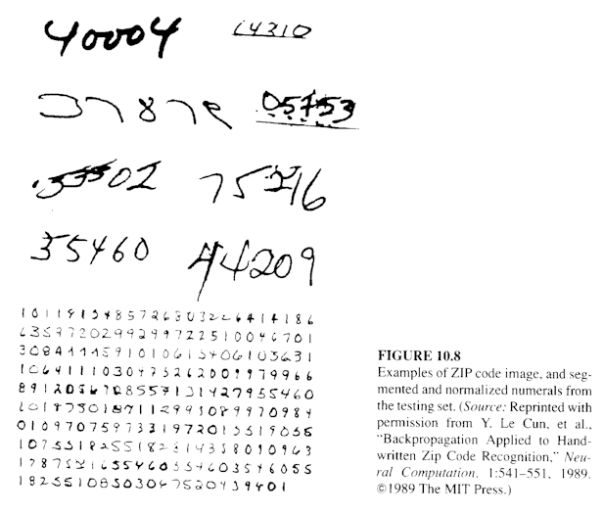
Handwritten Digit Recognition
Machine Learning @ BAUST, Session 2, July 2018
Notes:
NN 1
10-00
Elene Marchiori

Slide 28
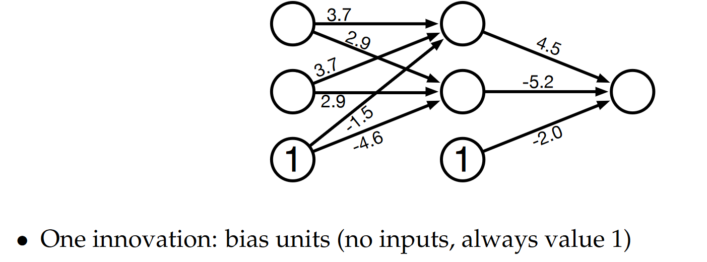
Example
Machine Learning @ BAUST, Session 2, July 2018

Slide 29
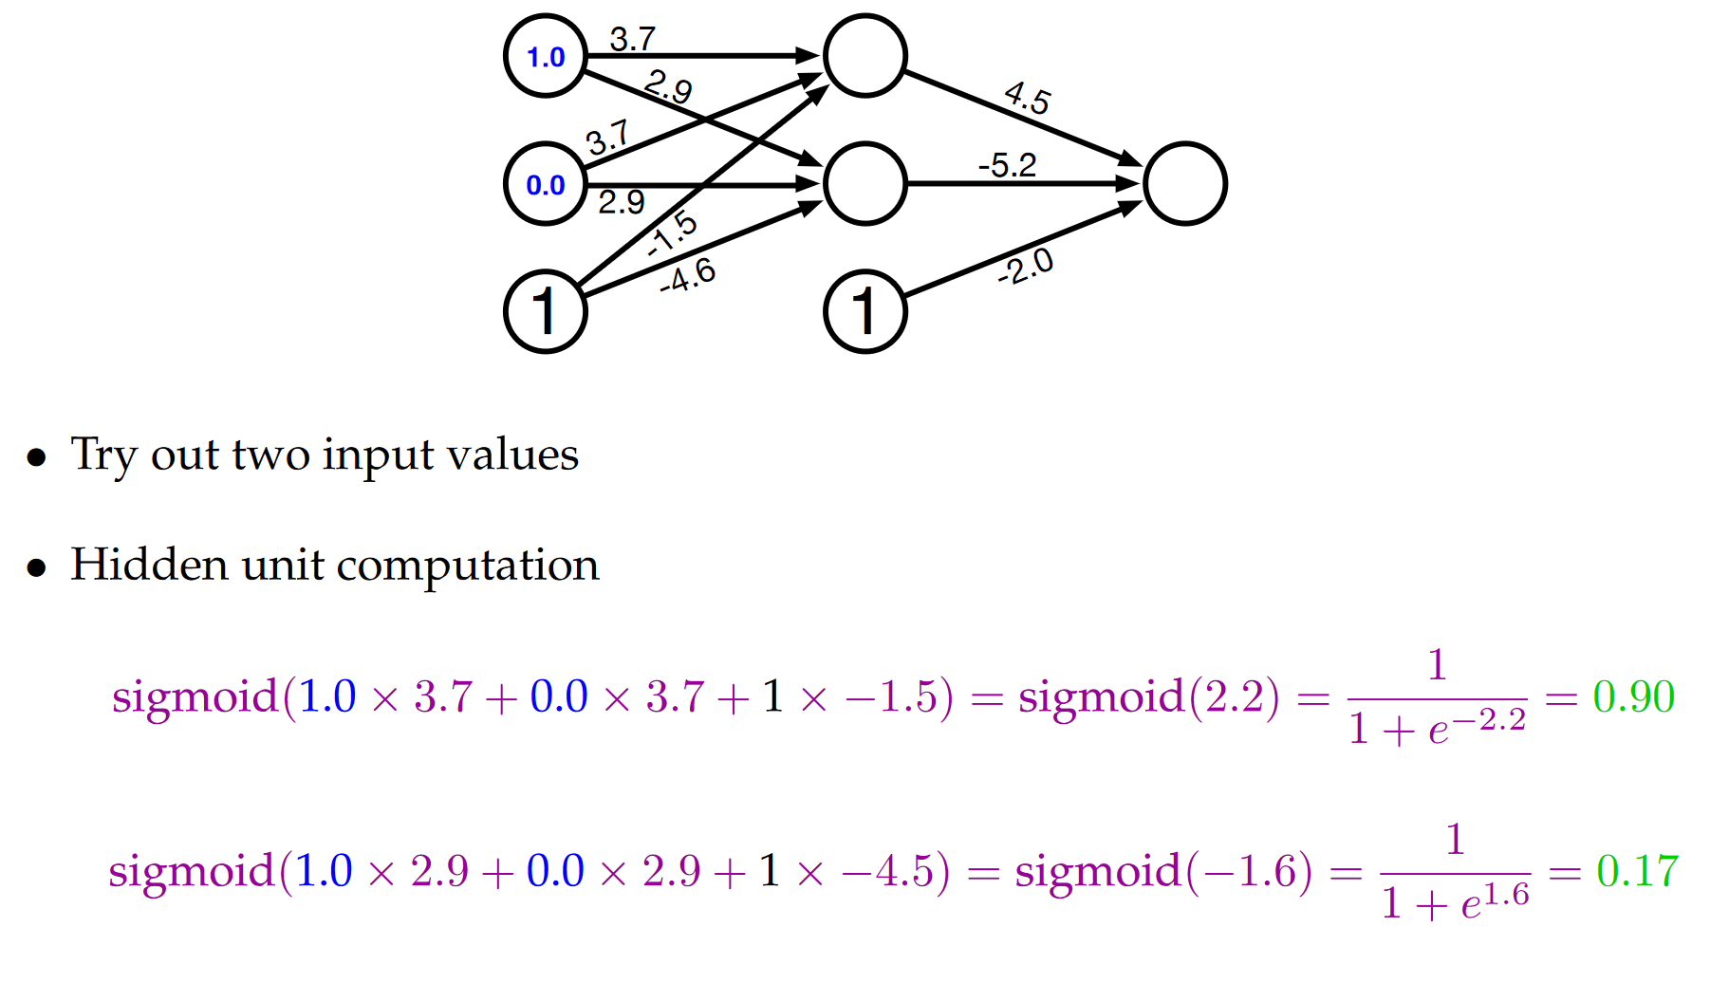
Example
Machine Learning @ BAUST, Session 2, July 2018

Slide 30
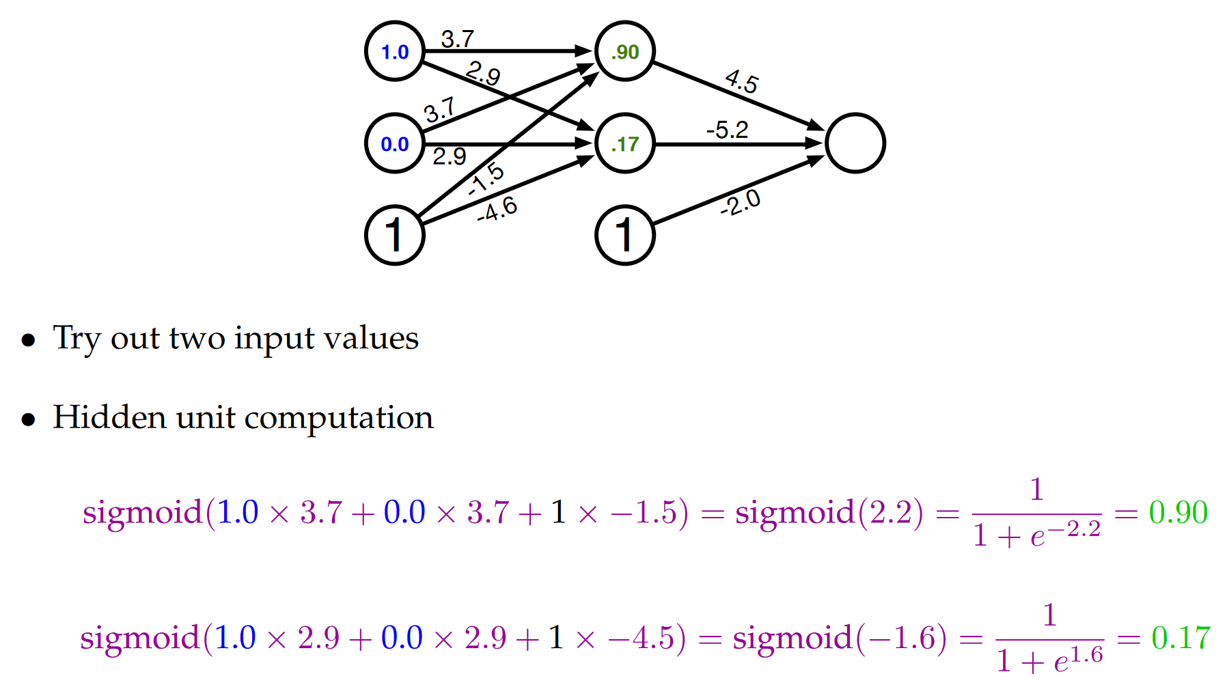
Example: Computed Hidden
Machine Learning @ BAUST, Session 2, July 2018

Slide 31
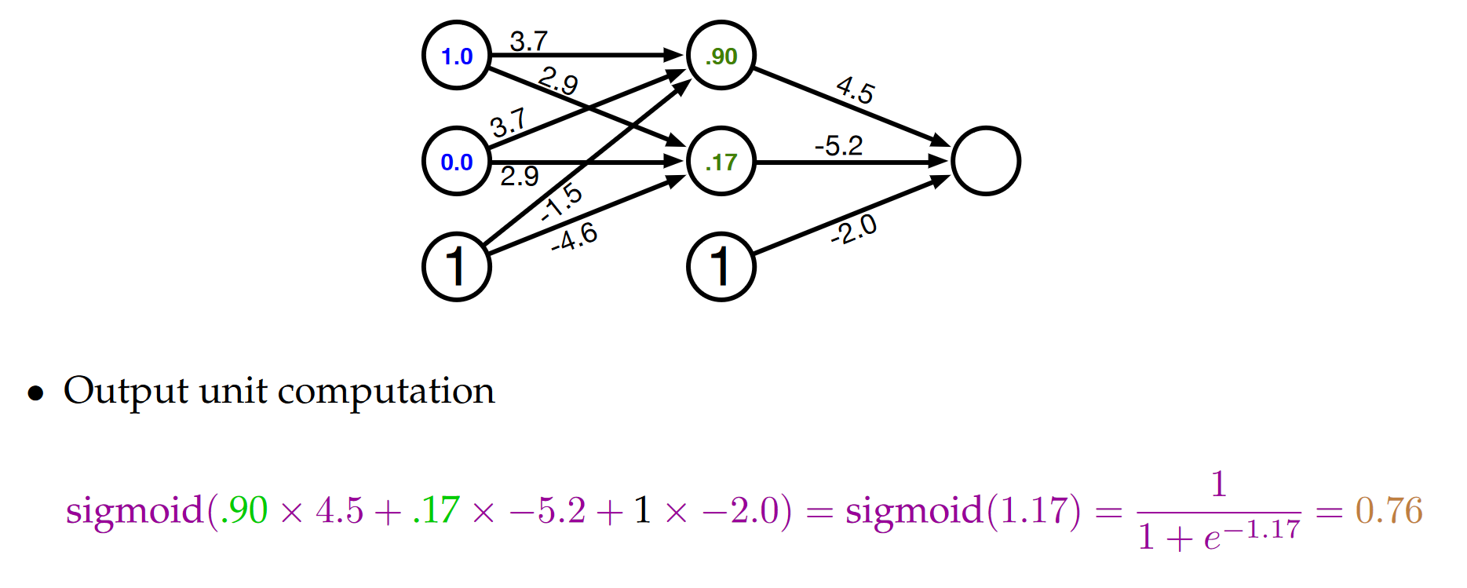
Example: Compute Output
Machine Learning @ BAUST, Session 2, July 2018

Slide 32
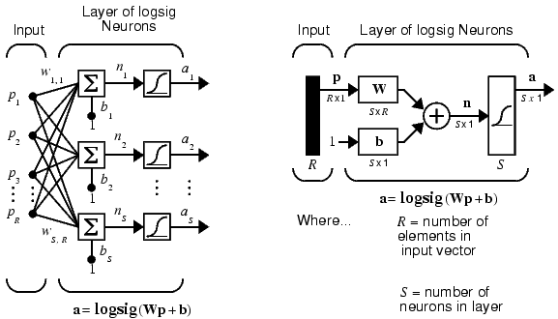
Architecture
Feedforward Network
A single-layer network of S logsig neurons having R inputs is shown below in full detail on the left and with a layer diagram on the right.

Slide 33
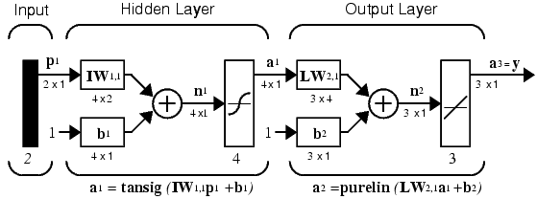
Architecture
Feedforward Network
Feedforward networks often have one or more hidden layers of sigmoid neurons followed by an output layer of linear neurons.
Multiple layers of neurons with nonlinear transfer functions allow the network to learn nonlinear and linear relationships between input and output vectors.
The linear output layer lets the network produce values outside the range -1 to +1. On the other hand, if you want to constrain the outputs of a network (such as between 0 and 1), then the output layer should use a sigmoid transfer function (such as logsig).

Slide 34
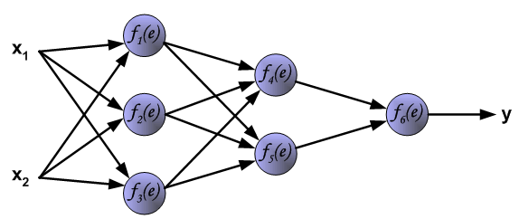
Learning Algorithm:
Backpropagation
The following slides describes teaching process of multi-layer neural network employing backpropagation algorithm. To illustrate this process the three layer neural network with two inputs and one output,which is shown in the picture below, is used:

Slide 35
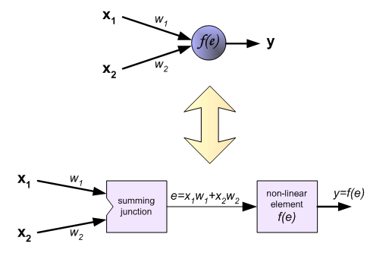
Learning Algorithm:
Backpropagation
Each neuron is composed of two units. First unit adds products of weights coefficients and input signals. The second unit realise nonlinear function, called neuron transfer (activation) function. Signal e is adder output signal, and y = f(e) is output signal of nonlinear element. Signal y is also output signal of neuron.

Slide 36
Learning Algorithm:
Backpropagation
To teach the neural network we need training data set. The training data set consists of input signals (x₁ and x₂ ) assigned with corresponding target (desired output) z.
The network training is an iterative process. In each iteration weights coefficients of nodes are modified using new data from training data set. Modification is calculated using algorithm described below:
Each teaching step starts with forcing both input signals from training set. After this stage we can determine output signals values for each neuron in each network layer.

Slide 37
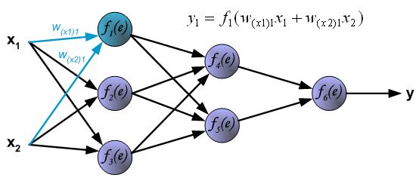
Learning Algorithm:
Backpropagation
Pictures below illustrate how signal is propagating through the network, Symbols w_{(xm)n} represent weights of connections between network input x_{m} and neuron n in input layer. Symbols y_{n} represents output signal of neuron n.

Slide 38
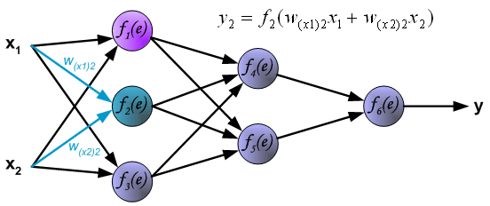
Learning Algorithm:
Backpropagation

Slide 39
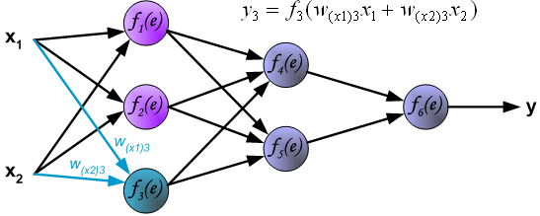
Learning Algorithm:
Backpropagation

Slide 40
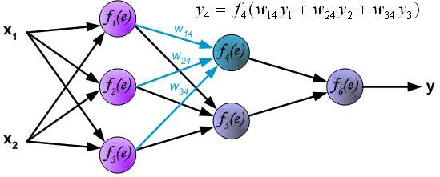
Learning Algorithm:
Backpropagation
Propagation of signals through the hidden layer. Symbols w_{mn} represent weights of connections between output of neuron m and input of neuron n in the next layer.

Slide 41
Learning Algorithm:
Backpropagation

Slide 42
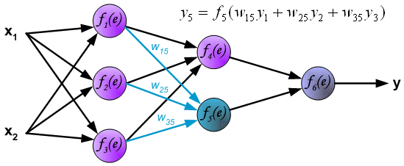
Learning Algorithm:
Backpropagation

Slide 43
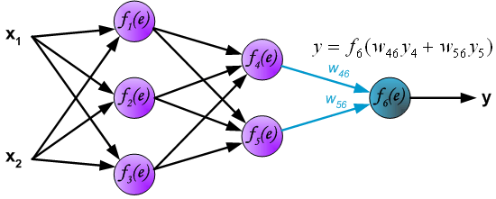
Learning Algorithm:
Backpropagation
Propagation of signals through the output layer.

Slide 44
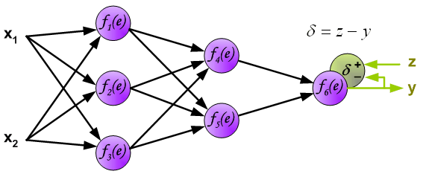
Learning Algorithm:
Backpropagation
In the next algorithm step the output signal of the network y is compared with the desired output value (the target), which is found in training data set. The difference is called error signal d of output layer neuron

Slide 45
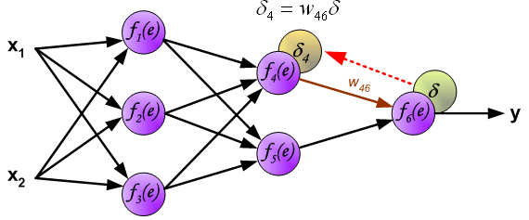
Learning Algorithm:
Backpropagation
The idea is to propagate error signal d (computed in single teaching step) back to all neurons, which output signals were input for discussed neuron.

Slide 46
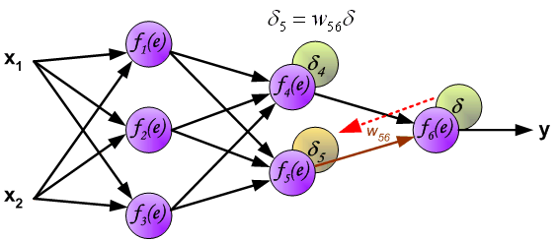
Learning Algorithm:
Backpropagation
The idea is to propagate error signal d (computed in single teaching step) back to all neurons, which output signals were input for discussed neuron.

Slide 47
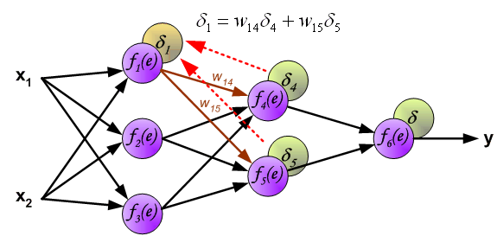
Learning Algorithm:
Backpropagation
The weights' coefficients w_{mn} used to propagate errors back are equal to this used during computing output value. Only the direction of data flow is changed (signals are propagated from output to inputs one after the other). This technique is used for all network layers. If propagated errors came from few neurons they are added. The illustration is below:

Slide 48
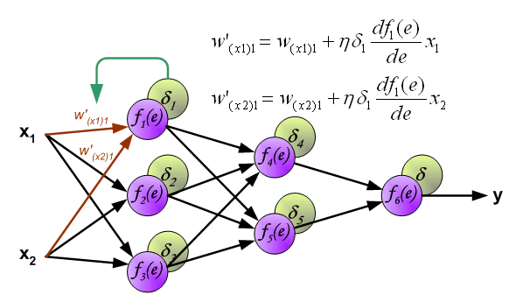
Learning Algorithm:
Backpropagation
When the error signal for each neuron is computed, the weights coefficients of each neuron input node may be modified. In formulas below df(e)/de represents derivative of neuron activation function (which weights are modified).

Slide 49
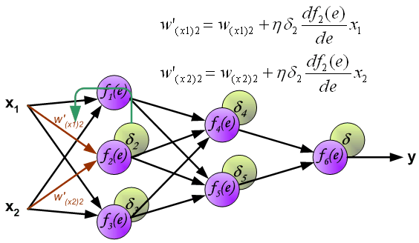
Learning Algorithm:
Backpropagation
When the error signal for each neuron is computed, the weights coefficients of each neuron input node may be modified. In formulas below df(e)/de represents derivative of neuron activation function (which weights are modified).

Slide 50
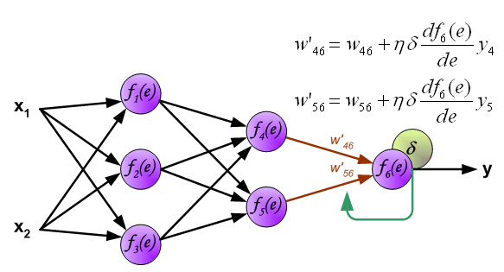
Learning Algorithm:
Backpropagation
When the error signal for each neuron is computed, the weights coefficients of each neuron input node may be modified. In formulas below df(e)/de represents derivative of neuron activation function (which weights are modified).

Slide 51
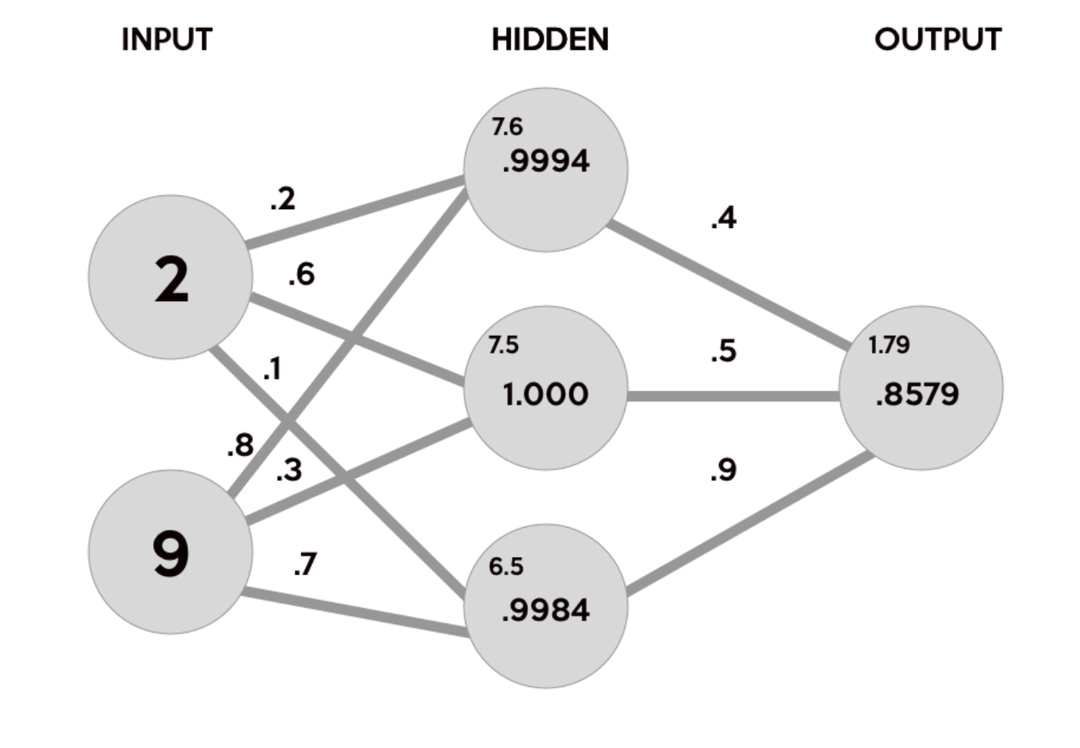
Using Python for NN
Machine Learning @ BAUST, Session 2, July 2018

Slide 52
Using Python for NN
import numpy as np
# X = (hours sleeping, hours studying), y = score on test
X = np.array(([2, 9], [1, 5], [3, 6]), dtype=float)
y = np.array(([92], [86], [89]), dtype=float)
# scale units
X = X/np.amax(X, axis=0)
# maximum of X array
y = y/100 # max test score is 100
Machine Learning @ BAUST, Session 2, July 2018

Slide 53
Using Python for NN
class Neural_Network(object):
def __init__(self):
#parameters
self.inputSize = 2
self.outputSize = 1
self.hiddenSize = 3
Machine Learning @ BAUST, Session 2, July 2018

Slide 54
Using Python for NN
#weights
self.W1 = np.random.randn(self.inputSize, self.hiddenSize)
# (3x2) weight matrix from input to hidden layer
self.W2 = np.random.randn(self.hiddenSize, self.outputSize)
# (3x1) weight matrix from hidden to output layer
Machine Learning @ BAUST, Session 2, July 2018

Slide 55
Using Python for NN
def forward(self, X):
#forward propagation through our network
self.z = np.dot(X, self.W1)
# dot product of X (input) and first set of 3x2 weights
self.z2 = self.sigmoid(self.z) # activation function
self.z3 = np.dot(self.z2, self.W2)
# dot product of hidden layer (z2) and second set of 3x1 weights
o = self.sigmoid(self.z3) # final activation function return o
Machine Learning @ BAUST, Session 2, July 2018

Slide 56
Using Python for NN
def sigmoid(self, s):
# activation function
return 1/(1+np.exp(-s))
NN = Neural_Network()
#defining our output
o = NN.forward(X)
print "Predicted Output: \n" + str(o)
print "Actual Output: \n" + str(y)
Machine Learning @ BAUST, Session 2, July 2018

Slide 57

Working with Python
Machine Learning @ BAUST, Session 2, July 2018

Slide 58
Python Libraries for Data Science
Many popular Python toolboxes/libraries:
  NumPy
  SciPy
  Pandas
  SciKit-Learn
Visualization libraries
  matplotlib
  Seaborn
  and many more …
All these libraries are installed on the SCC
Machine Learning @ BAUST, Session 2, July 2018

Slide 59

Python Libraries for Data Science
NumPy:
  introduces objects for multidimensional arrays and matrices, as well as functions that allow to easily perform advanced mathematical and statistical operations on those objects
  provides vectorization of mathematical operations on arrays and matrices which significantly improves the performance
  many other python libraries are built on NumPy
Link: http://www.numpy.org/
Machine Learning @ BAUST, Session 2, July 2018

Slide 60

Python Libraries for Data Science
SciPy:
  collection of algorithms for linear algebra, differential equations, numerical integration, optimization, statistics and more
  part of SciPy Stack
  built on NumPy
Link: https://www.scipy.org/scipylib/
Machine Learning @ BAUST, Session 2, July 2018

Slide 61
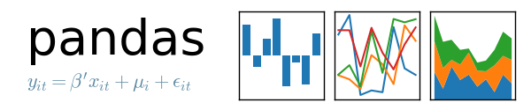
Python Libraries for Data Science
Pandas:
  adds data structures and tools designed to work with table-like data (similar to Series and Data Frames in R)
  provides tools for data manipulation: reshaping, merging, sorting, slicing, aggregation etc.
  allows handling missing data
Link: http://pandas.pydata.org/
Machine Learning @ BAUST, Session 2, July 2018

Slide 62

Python Libraries for Data Science
SciKit-Learn:
  provides machine learning algorithms: classification, regression, clustering, model validation etc.
  built on NumPy, SciPy and matplotlib
Link: http://scikit-learn.org/
Machine Learning @ BAUST, Session 2, July 2018

Slide 63

Python Libraries for Data Science
matplotlib:
  python 2D plotting library which produces publication quality figures in a variety of hardcopy formats
  a set of functionalities similar to those of MATLAB
  line plots, scatter plots, barcharts, histograms, pie charts etc.
  relatively low-level; some effort needed to create advanced visualization
Link: https://matplotlib.org/
Machine Learning @ BAUST, Session 2, July 2018

Slide 64
Python Libraries for Data Science
Seaborn:
  based on matplotlib
  provides high level interface for drawing attractive statistical graphics
  Similar (in style) to the popular ggplot2 library in R
Link: https://seaborn.pydata.org/
Machine Learning @ BAUST, Session 2, July 2018

Slide 65
Selecting Python Version
# view available python versions on the SCC
[scc1 ~] module avail python
# load python 3 version
[scc1 ~] module load python/3.6.2
Machine Learning @ BAUST, Session 2, July 2018

Slide 66
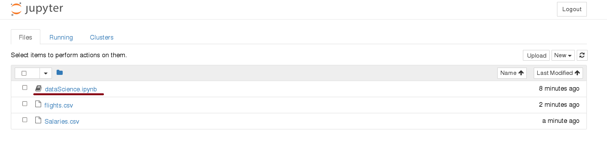
Start Jupyter Notebook
# On the Shared Computing Cluster
[scc1 ~] jupyter notebook
Machine Learning @ BAUST, Session 2, July 2018

Slide 67
Loading Python Libraries
In [ ]:
#Import Python Libraries
import numpy as np
import scipy as sp
import pandas as pd
import matplotlib as mpl
import seaborn as sns
Press Shift+Enter to execute the jupyter cell
Machine Learning @ BAUST, Session 2, July 2018

Slide 68
Reading data using pandas
#Read csv file
df = pd.read_csv("http://rcs.bu.edu/examples/python/data_analysis/Salaries.csv")
In [ ]:
Note: The above command has many optional arguments to fine-tune the data import process.
There is a number of pandas commands to read other data formats:
pd.read_excel('myfile.xlsx',sheet_name='Sheet1', index_col=None, na_values=['NA'])
pd.read_stata('myfile.dta')
pd.read_sas('myfile.sas7bdat')
pd.read_hdf('myfile.h5','df')
Machine Learning @ BAUST, Session 2, July 2018

Slide 69
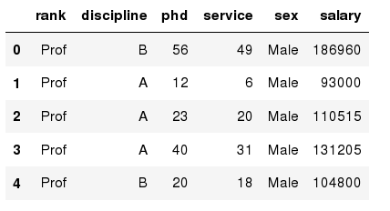
Exploring data frames
In [3]:
#List first 5 records
df.head()
Out[3]:
Machine Learning @ BAUST, Session 2, July 2018

Slide 70
Data Frame data types
In [4]:
#Check a particular column type
df['salary'].dtype
Out[4]: dtype('int64')
In [5]:
#Check types for all the columns
df.dtypes
Out[4]:
object
object
int64
int64
object
int64
rank
discipline
phd
service
sex
salary
dtype: object
Machine Learning @ BAUST, Session 2, July 2018

Slide 71
Data Frames attributes
Python objects have attributes and methods.
df.attribute | description
dtypes | list the types of the columns
columns | list the column names
axes | list the row labels and column names
ndim | number of dimensions
size | number of elements
shape | return a tuple representing the dimensionality
values | numpy representation of the data
Machine Learning @ BAUST, Session 2, July 2018

Slide 72
Data Frames methods
Unlike attributes, python methods have parenthesis.
All attributes and methods can be listed with a dir() function: dir(df)
df.method() | description
head( [n] ), tail( [n] ) | first/last n rows
describe() | generate descriptive statistics (for numeric columns only)
max(), min() | return max/min values for all numeric columns
mean(), median() | return mean/median values for all numeric columns
std() | standard deviation
sample([n]) | returns a random sample of the data frame
dropna() | drop all the records with missing values
Machine Learning @ BAUST, Session 2, July 2018

Slide 73
Selecting a column in a Data Frame
Method 1: Subset the data frame using column name:
df['sex']
Method 2: Use the column name as an attribute:
df.sex
Note: there is an attribute rank for pandas data frames, so to select a column with a name "rank" we should use method 1.
Machine Learning @ BAUST, Session 2, July 2018

Slide 74
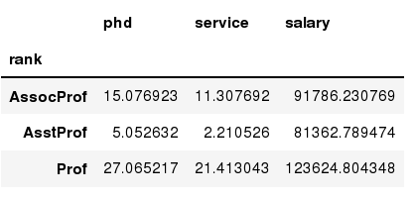
Data Frames groupby method
Using "group by" method we can:
  Split the data into groups based on some criteria
  Calculate statistics (or apply a function) to each group
  Similar to dplyr() function in R
In [ ]:
#Group data using rank
df_rank = df.groupby(['rank'])
In [ ]:
#Calculate mean value for each numeric column per each group
df_rank.mean()
Machine Learning @ BAUST, Session 2, July 2018

Slide 75
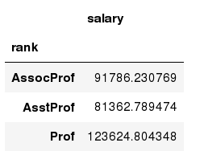
Data Frames groupby method
Once groupby object is create we can calculate various statistics for each group:
In [ ]:
#Calculate mean salary for each professor rank:
df.groupby('rank')[['salary']].mean()
Note: If single brackets are used to specify the column (e.g. salary), then the output is Pandas Series object. When double brackets are used the output is a Data Frame
Machine Learning @ BAUST, Session 2, July 2018

Slide 76
Data Frames groupby method
groupby performance notes:
  - no grouping/splitting occurs until it's needed. Creating the groupby object only verifies that you have passed a valid mapping
  - by default the group keys are sorted during the groupby operation. You may want to pass sort=False for potential speedup:
In [ ]:
#Calculate mean salary for each professor rank:
df.groupby(['rank'], sort=False)[['salary']].mean()
Machine Learning @ BAUST, Session 2, July 2018

Slide 77
Data Frame: filtering
To subset the data we can apply Boolean indexing. This indexing is commonly known as a filter. For example if we want to subset the rows in which the salary value is greater than $120K:
In [ ]:
#Calculate mean salary for each professor rank:
df_sub = df[ df['salary'] > 120000 ]
Any Boolean operator can be used to subset the data:
> greater; >= greater or equal;
< less; <= less or equal;
== equal; != not equal;
In [ ]:
#Select only those rows that contain female professors:
df_f = df[ df['sex'] == 'Female' ]
Machine Learning @ BAUST, Session 2, July 2018

Slide 78
Data Frames: Slicing
There are a number of ways to subset the Data Frame:
  one or more columns
  one or more rows
  a subset of rows and columns
  Rows and columns can be selected by their position or label
Machine Learning @ BAUST, Session 2, July 2018

Slide 79
Data Frames: Slicing
When selecting one column, it is possible to use single set of brackets, but the resulting object will be a Series (not a DataFrame):
In [ ]:
#Select column salary:
df['salary']
When we need to select more than one column and/or make the output to be a DataFrame, we should use double brackets:
In [ ]:
#Select column salary:
df[['rank','salary']]
Machine Learning @ BAUST, Session 2, July 2018

Slide 80
Data Frames: Selecting rows
If we need to select a range of rows, we can specify the range using ":"
In [ ]:
#Select rows by their position:
df[10:20]
Notice that the first row has a position 0, and the last value in the range is omitted:
So for 0:10 range the first 10 rows are returned with the positions starting with 0 and ending with 9
Machine Learning @ BAUST, Session 2, July 2018

Slide 81
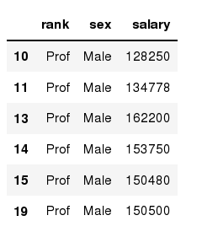
Data Frames: method loc
If we need to select a range of rows, using their labels we can use method loc:
In [ ]:
#Select rows by their labels:
df_sub.loc[10:20,['rank','sex','salary']]
Out[ ]:
Machine Learning @ BAUST, Session 2, July 2018

Slide 82

Data Frames: method iloc
If we need to select a range of rows and/or columns, using their positions we can use method iloc:
In [ ]:
#Select rows by their labels:
df_sub.iloc[10:20,[0, 3, 4, 5]]
Out[ ]:
Machine Learning @ BAUST, Session 2, July 2018

Slide 83
Data Frames: method iloc (summary)
df.iloc[0] # First row of a data frame
df.iloc[i] #(i+1)th row
df.iloc[-1] # Last row
df.iloc[:, 0] # First column
df.iloc[:, -1] # Last column
df.iloc[0:7] #First 7 rows
df.iloc[:, 0:2] #First 2 columns
df.iloc[1:3, 0:2] #Second through third rows and first 2 columns
df.iloc[[0,5], [1,3]] #1st and 6th rows and 2nd and 4th columns
Machine Learning @ BAUST, Session 2, July 2018

Slide 84

Data Frames: Sorting
We can sort the data by a value in the column. By default the sorting will occur in ascending order and a new data frame is return.
In [ ]:
# Create a new data frame from the original sorted by the column Salary
df_sorted = df.sort_values( by ='service')
df_sorted.head()
Out[ ]:
Machine Learning @ BAUST, Session 2, July 2018

Slide 85

Data Frames: Sorting
We can sort the data using 2 or more columns:
In [ ]:
df_sorted = df.sort_values( by =['service', 'salary'], ascending = [True, False])
df_sorted.head(10)
Out[ ]:
Machine Learning @ BAUST, Session 2, July 2018

Slide 86

Missing Values
Missing values are marked as NaN
In [ ]:
# Read a dataset with missing values
flights = pd.read_csv("http://rcs.bu.edu/examples/python/data_analysis/flights.csv")
In [ ]:
# Select the rows that have at least one missing value
flights[flights.isnull().any(axis=1)].head()
Out[ ]:
Machine Learning @ BAUST, Session 2, July 2018

Slide 87
Missing Values
There are a number of methods to deal with missing values in the data frame:
df.method() | description
dropna() | Drop missing observations
dropna(how='all') | Drop observations where all cells is NA
dropna(axis=1, how='all') | Drop column if all the values are missing
dropna(thresh = 5) | Drop rows that contain less than 5 non-missing values
fillna(0) | Replace missing values with zeros
isnull() | returns True if the value is missing
notnull() | Returns True for non-missing values
Machine Learning @ BAUST, Session 2, July 2018

Slide 88
Missing Values
When summing the data, missing values will be treated as zero
If all values are missing, the sum will be equal to NaN
cumsum() and cumprod() methods ignore missing values but preserve them in the resulting arrays
Missing values in GroupBy method are excluded (just like in R)
Many descriptive statistics methods have skipna option to control if missing data should be excluded . This value is set to True by default (unlike R)
Machine Learning @ BAUST, Session 2, July 2018

Slide 89
Aggregation Functions in Pandas
Aggregation - computing a summary statistic about each group, i.e.
  compute group sums or means
  compute group sizes/counts
Common aggregation functions:
  min, max
  count, sum, prod
  mean, median, mode, mad
  std, var
Machine Learning @ BAUST, Session 2, July 2018

Slide 90

Aggregation Functions in Pandas
agg() method are useful when multiple statistics are computed per column:
In [ ]:
flights[['dep_delay','arr_delay']].agg(['min','mean','max'])
Out[ ]:
Machine Learning @ BAUST, Session 2, July 2018

Slide 91
Basic Descriptive Statistics
df.method() | description
describe | Basic statistics (count, mean, std, min, quantiles, max)
min, max | Minimum and maximum values
mean, median, mode | Arithmetic average, median and mode
var, std | Variance and standard deviation
sem | Standard error of mean
skew | Sample skewness
kurt | kurtosis
Machine Learning @ BAUST, Session 2, July 2018

Slide 92
Graphics to explore the data
Seaborn package is built on matplotlib but provides high level interface for drawing attractive statistical graphics, similar to ggplot2 library in R. It specifically targets statistical data visualization
To show graphs within Python notebook include inline directive:
In [ ]:
%matplotlib inline
Machine Learning @ BAUST, Session 2, July 2018

Slide 93
Graphics
 | description
distplot | histogram
barplot | estimate of central tendency for a numeric variable
violinplot | similar to boxplot, also shows the probability density of the data
jointplot | Scatterplot
regplot | Regression plot
pairplot | Pairplot
boxplot | boxplot
swarmplot | categorical scatterplot
factorplot | General categorical plot
Machine Learning @ BAUST, Session 2, July 2018

Slide 94
Basic statistical Analysis
statsmodel and scikit-learn - both have a number of function for statistical analysis
The first one is mostly used for regular analysis using R style formulas, while scikit-learn is more tailored for Machine Learning.
statsmodels:
  linear regressions
  ANOVA tests
  hypothesis testings
  many more ...
scikit-learn:
  kmeans
  support vector machines
  random forests
  many more ...
See examples in the Tutorial Notebook
Machine Learning @ BAUST, Session 2, July 2018

Slide 95

Machine Learning @ BAUST, Session 2, July 2018

Slide 96
ML Research
Tensorflow for deep learning research
Tensorflow based ML application development
ConvNet in Tensorflow
RNN and Tensor-2-Tensor
Machine Learning @ BAUST, Session 2, July 2018

Slide 97
Class Test on ANN
Time: 20mins
What is printed by the Python code?
Be careful: Note the backslashes:
print('how\nis it\nnow')
What is printed by the Python code?
print('2' + '3')
What is printed by the Python code?
print(2*'No' + 3*'!')
print(2 * ('No' + 3*'!'))
Machine Learning @ BAUST, Session 2, July 2018

Slide 98
Class Test on ANN
Time: 20mins
What is printed by the Python code?
def func(x):
return x - 1
print(func(3) * func(5))
What is printed by the Python code?
x = 2.5679
y = 9.0
print('Answers {:.3f} and {:.3f}'.format(x, y))
Machine Learning @ BAUST, Session 2, July 2018

Slide 99
Class Test on ANN
Time: 20mins
A 3-input neuron is trained to output a zero when the input is 110 and a one when the input is 111. After generalisation, the output will be zero when and only when the input is:
(a) 000 or 110 or 011 or 101
(b) 010 or 100 or 110 or 101
(c) 000 or 010 or 110 or 100
Machine Learning @ BAUST, Session 2, July 2018

Slide 100
Class Test on ANN
Time: 20mins
A perceptron is:
(a) a single layer feed-forward neural network with preprocessing
(b) an autoassociative neural network
(c) a double layer autoassociative neural network
Machine Learning @ BAUST, Session 2, July 2018

Slide 101
Class Test on ANN
Time: 20mins
Knowledge that is written down in the form of instructions is a form of what?
a) Tacit knowledge
b) Explicit knowledge
c) Embodied knowledge
d) Deep knowledge
Machine Learning @ BAUST, Session 2, July 2018

Slide 102
Class Test on ANN
Time: 20mins
A 4-input neuron has weights 1, 2, 3 and 4. The transfer function is linear with the constant of proportionality being equal to 2. The inputs are 4, 10, 5 and 20 respectively. The output will be:
(a) 238
(b) 76
(c) 119
Machine Learning @ BAUST, Session 2, July 2018

Slide 103
Class Test on ANN
Time: 20mins
Which of the following is true for neural networks?
(i) The training time depends on the size of the network.
(ii) Neural networks can be simulated on a conventional computer.
(iii)Artificial neurons are identical in operation to biological ones.
(a) all of them are true. (b) (ii) is true. (c) (i) and (ii) are true.
Machine Learning @ BAUST, Session 2, July 2018

Slide 104
Class Test on ANN
Time: 20mins
Which of the following is true?
(i) On average, neural networks have higher computational rates than conventional computers.
(ii) Neural networks learn by example.
(iii) Neural networks mimic the way the human brain works.
(a) all of them are true (b) (ii) and (iii) are true (c) (i), (ii) and (iii) are true
Machine Learning @ BAUST, Session 2, July 2018

Slide 105
Your Questions?
Thanks for your patience hearing.
Machine Learning @ BAUST, Session 2, July 2018

